Slide 1

Department of Computer Science & Engineering Smart Hospital Management System 1. CH. SREE VATSAV 2. C.RITHIK 3.ASAR.ABUZAR
Maisammaguda, Kompally, Medchal - Malkajgiri District Hyderabad - 500100, Telangana State. www.mallareddyuniversity.
(Telangana State Private Universities Act No. 13 of 2020 &
G.O.Ms. No. 14, Higher Education (UE) Department)

Slide 2
Table of Contents
Introduction
Literature Review
Problem Statement
Objectives
Methodology
Implementation
Results
Conclusion
Future Scope
References

Slide 3
Introduction
The Smart Hospital Management System is a web-based application developed using Spring Boot, MySQL, HTML, CSS, JavaScript, and Thymeleaf.
It helps hospitals manage patient records, doctor information, appointments, prescriptions, and billing through a secure digital platform.
The system reduces paperwork, improves efficiency, and provides better healthcare services.

Slide 4
Literature Review
Existing hospital management systems mainly focus on storing patient records and appointment scheduling.
Many traditional systems still rely on manual paperwork, which causes delays, errors, and difficulty in managing hospital data.
Our proposed system provides a secure, centralized, and user-friendly solution with role-based access for Admin, Doctor, and Patient.

Slide 5
Problem Statement
Manual record maintenance
Time-consuming appointment scheduling
Paper-based prescriptions
Billing errors
Difficulty in retrieving patient records
Lack of centralized data management
Our project solves these problems by providing a fully digital hospital management system.

Slide 6
Objectives
Automate hospital operations
Maintain digital patient records
Simplify appointment booking
Generate bills automatically
Reduce paperwork
Improve communication between doctors and patients
Secure hospital data using role-based authentication

Slide 7
Methodology
1. Patient Registration and Login
2. Admin manages Doctors and Patients
3. Patient books an appointment
4. Doctor accepts appointment
5. Doctor provides diagnosis and prescription
6. Bill is generated automatically
7. Patient records are stored securely in MySQL database

Slide 8
Implementation
Frontend: HTML, CSS, JavaScript, Thymeleaf
Backend: Spring Boot, Spring MVC, Spring Security, Spring Data JPA
Database: MySQL
Development Tools: STS (Spring Tool Suite), MySQL Workbench, Maven, Git & GitHub, Postman

Slide 9
Results
Secure login for different users
Easy appointment booking
Digital prescriptions
Automatic billing
Patient medical history
Fast retrieval of hospital records
Improved hospital efficiency

Slide 10
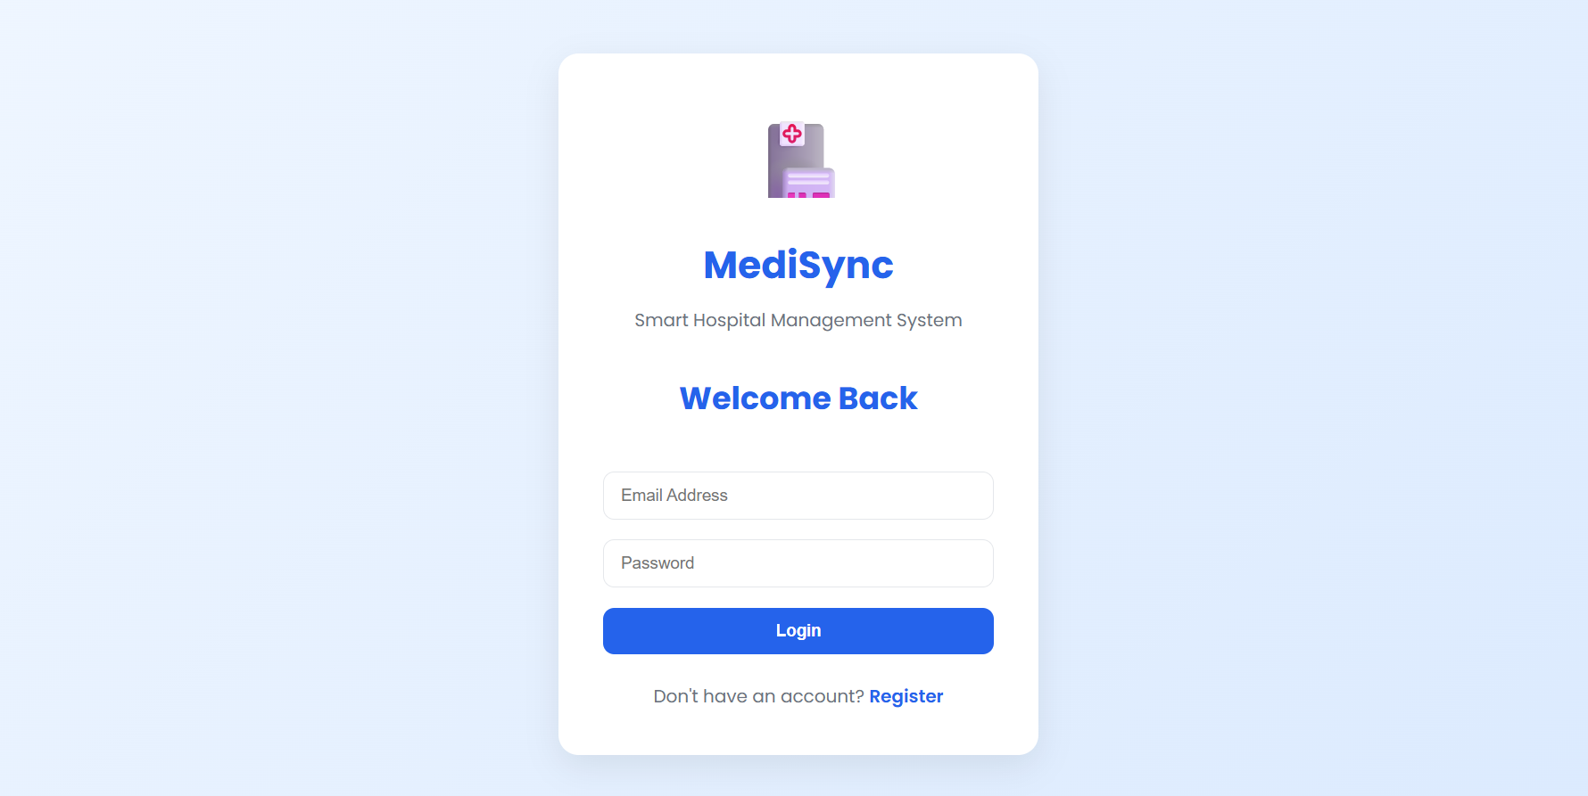
Screenshots
Login

Slide 11
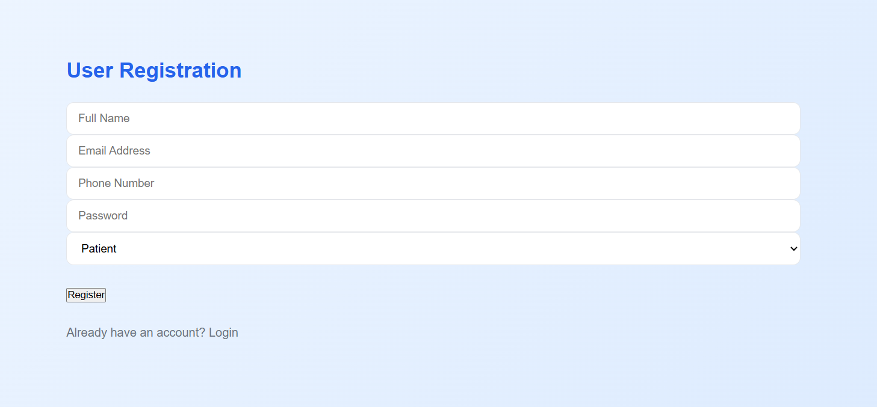
Register

Slide 12
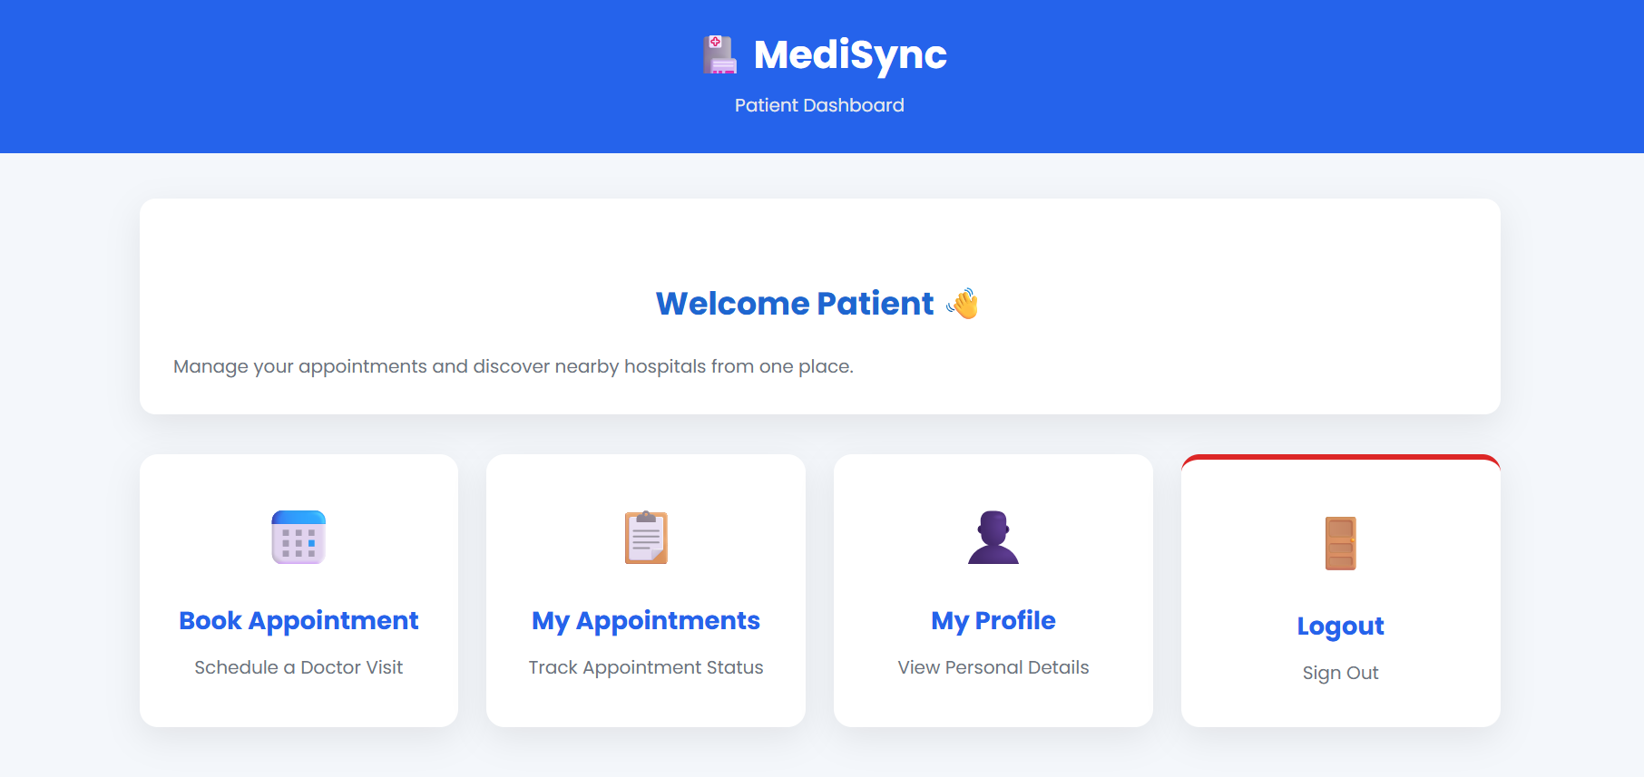
Patient dashboard

Slide 13
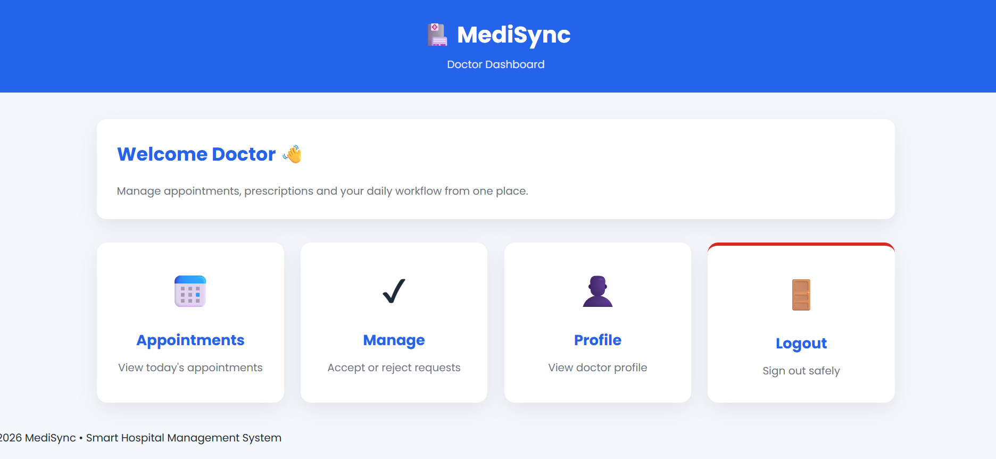
Doctor Dashboard

Slide 14
Future Scope
AI-based Disease Prediction
Online Payment Gateway
Video Consultation
Mobile Application
SMS & Email Notifications
Cloud Deployment
QR Code for Patient Records
Laboratory Integration

Slide 15
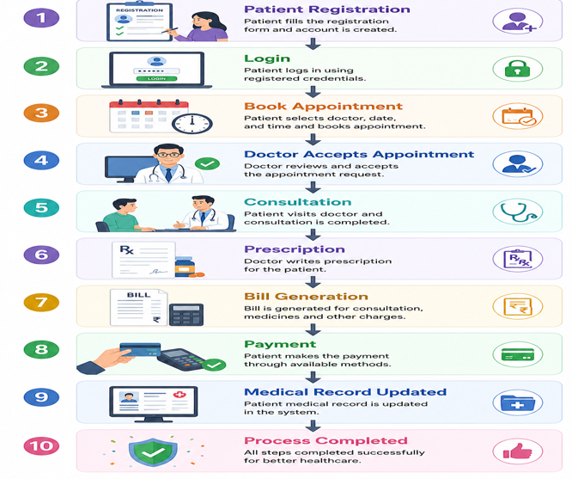
Project WorkFlow

Slide 16
References
Spring Boot Documentation
MySQL Documentation
Thymeleaf Documentation
Oracle Java Documentation
HTML, CSS, JavaScript (MDN Web Docs)
Spring Security Documentation
GitHub Documentation

Slide 17
Conclusion
The Smart Hospital Management System provides a secure, efficient, and user-friendly solution for hospital operations.
It reduces manual work, improves data accuracy, saves time, and enhances communication between patients and healthcare providers.

Slide 18
THANK YOU

